Slide 1
5
APPLICATIONS OF INTEGRATION
Copyright © Cengage Learning. All rights reserved.

Slide 2
5.5
Area of a Surface of Revolution
Copyright © Cengage Learning. All rights reserved.

Slide 3
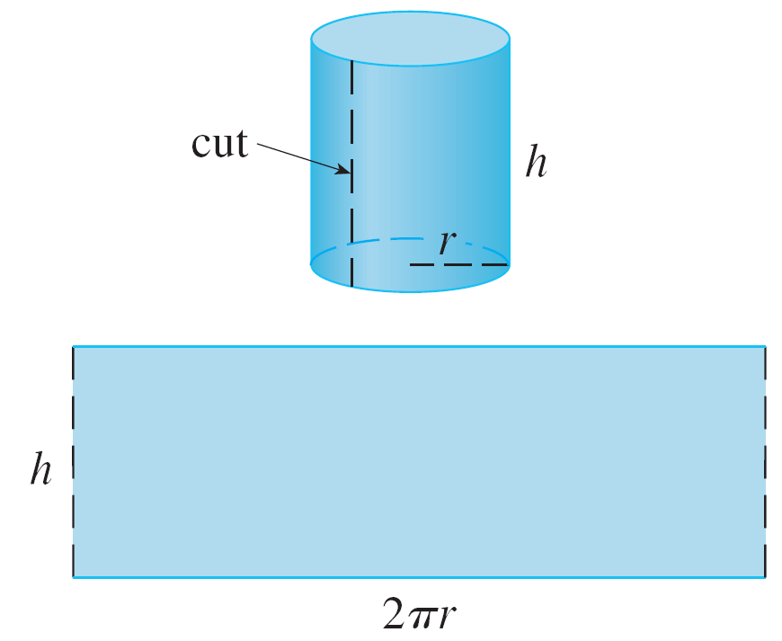
Area of a Surface of Revolution
A surface of revolution is formed when a curve is rotated about a line.
Let’s start with some simple surfaces.
The lateral surface area of a
circular cylinder with radius r
and height h is taken to be
A = 2π rh because we can
imagine cutting the cylinder
and unrolling it (as in Figure 1)
to obtain a rectangle with
dimensions 2π r and h.
Figure 1

Slide 4
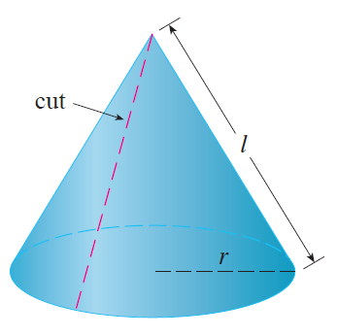
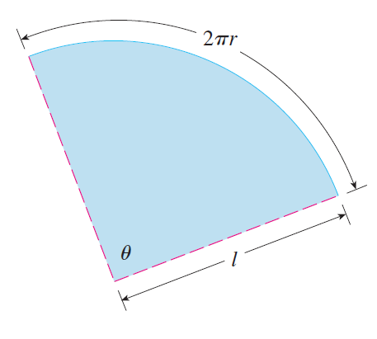
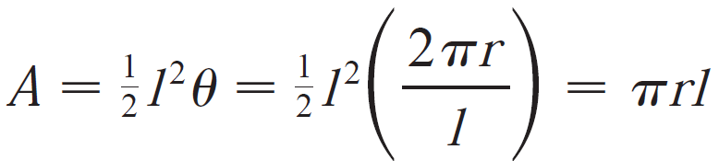
Area of a Surface of Revolution
Likewise, we can take a circular cone with base radius r and slant height l, cut it along the dashed line in Fig.2, and flatten it to form a sector of a circle with radius l and central angle θ=2πr/l.
We know that, in general, the area of a sector of a circle with radius l and angle θ is ½ l²θ.
So, the area of the circular cone
is
Figure 2

Slide 5
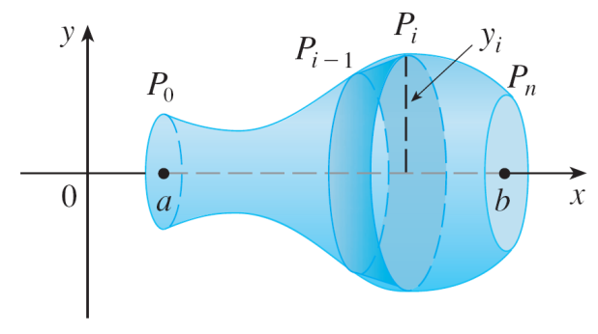
Area of a Surface of Revolution
What about more complicated surfaces of revolution?
If we follow the strategy we used with arc length, we can approximate the original curve by a polygon.
When this polygon is rotated about an axis, it creates a simpler surface whose surface area approximates the actual surface area.
By taking a limit, we can determine the exact surface area.
The approximating surface, then, consists of a number of bands, each formed by rotating a line segment about an axis.

Slide 6
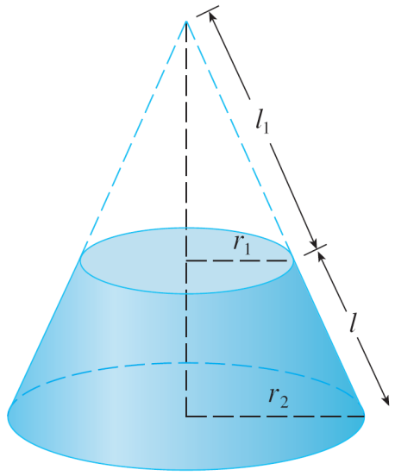

Area of a Surface of Revolution
To find the surface area, each of these bands can be considered a portion of a circular cone, as shown in
Figure 3.
The area of the band (or frustum of a cone)
with slant height l and upper and lower
radii r₁ and r₂ is found by subtracting the
areas of two cones:
Figure 3

Slide 7
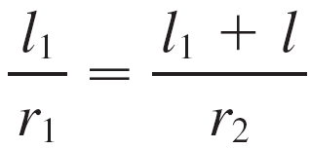






Area of a Surface of Revolution
From similar triangles we have
which gives
or
Putting this in Equation 1, we get
or
where is the average radius of the band.

Slide 8

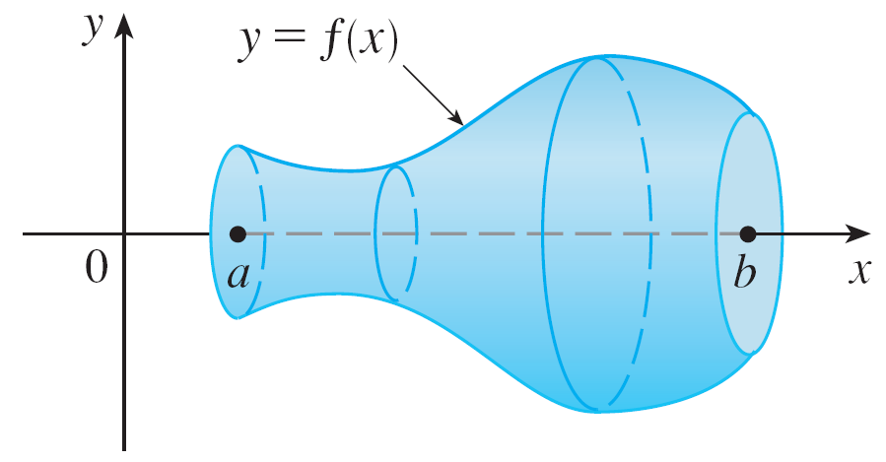

Area of a Surface of Revolution
Now we apply this formula to our strategy. Consider the surface shown in Figure 4, which is obtained by rotating the curve about the x-axis, where f is positive and has a continuous derivative.
In order to define its surface area, we divide the interval [a, b] into n subintervals with endpoints x₀, x₁, …, x_{n} and equal width Δx.
(a) Surface of revolution
(b) Approximating band
Figure 4

Slide 9


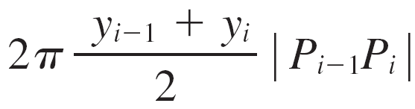
Area of a Surface of Revolution
If y_{i} = f(x_{i}), then the point P_{i}(x_{i}, y_{i}) lies on the curve.
The part of the surface between x_{i–1} and x_{i} is approximated by taking the line segment P_{i–1}P_{i} and rotating it about the x-axis.
The result is a band with slant height and average radius so, by Formula 2, its surface
area is

Slide 10
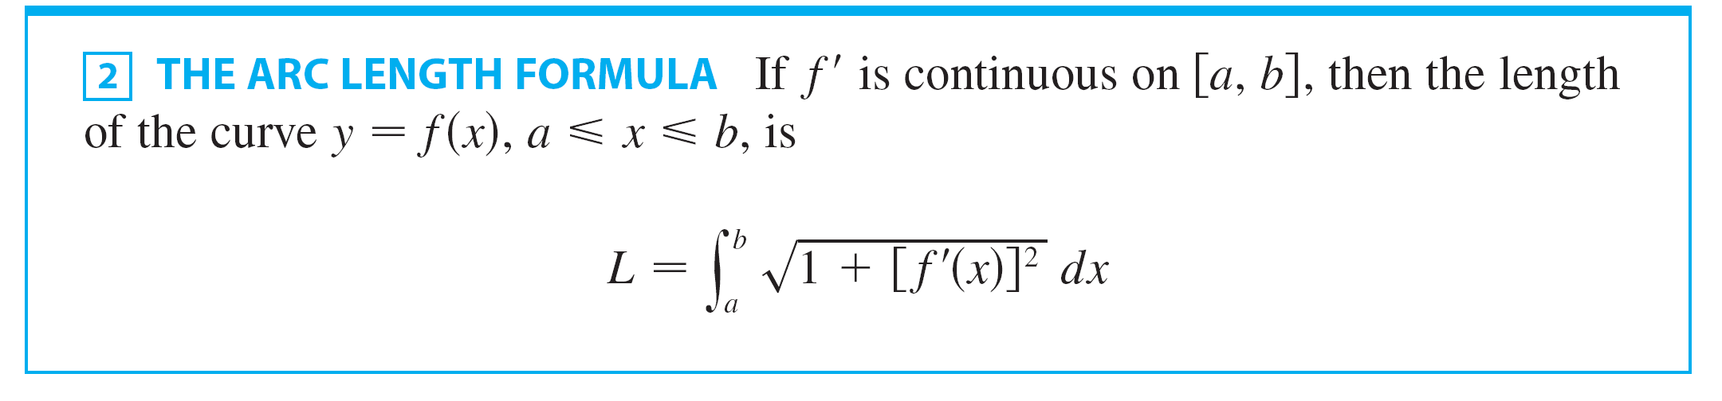
Area of a Surface of Revolution
The arc length formula is given as:

Slide 11
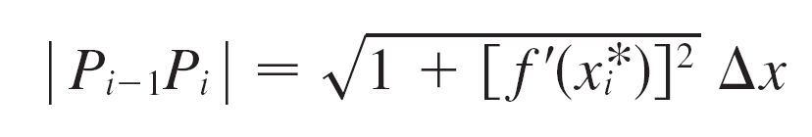



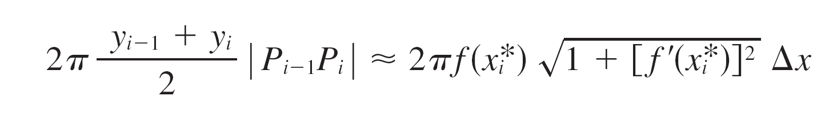
Area of a Surface of Revolution
Hence the length of the line segment P_{i–1}P_{i} is:
where is some number in [x_{i–1}, x_{i}]. When Δx is small, we have and also since f is continuous.
Therefore,

Slide 12
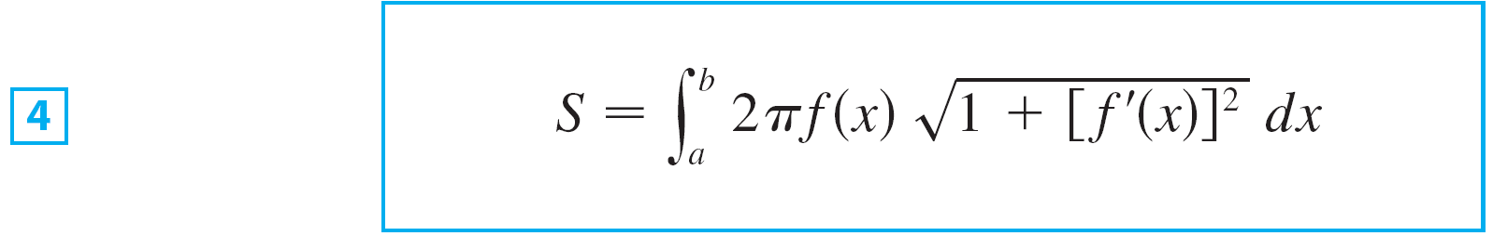
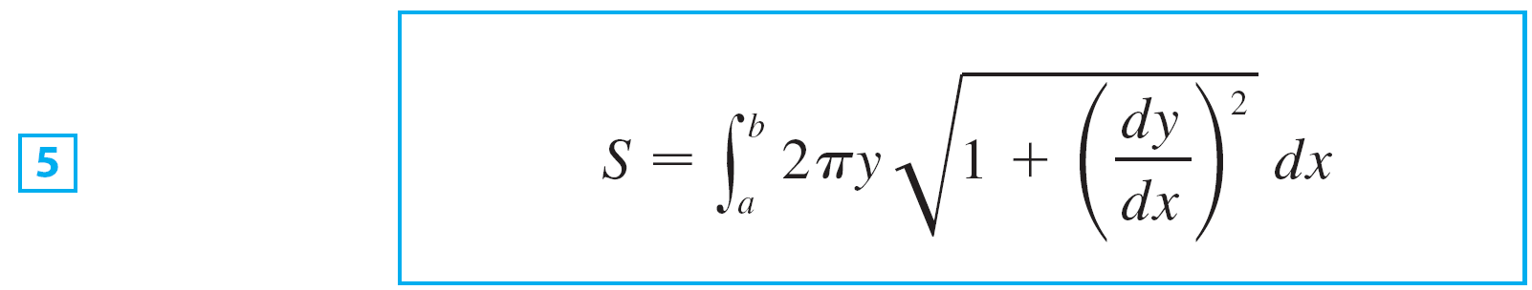
Area of a Surface of Revolution
Therefore, in the case where f is positive and has a continuous derivative, we define the surface area of the surface obtained by rotating the curve , about the x-axis as
With the Leibniz notation for derivatives, this formula becomes

Slide 13

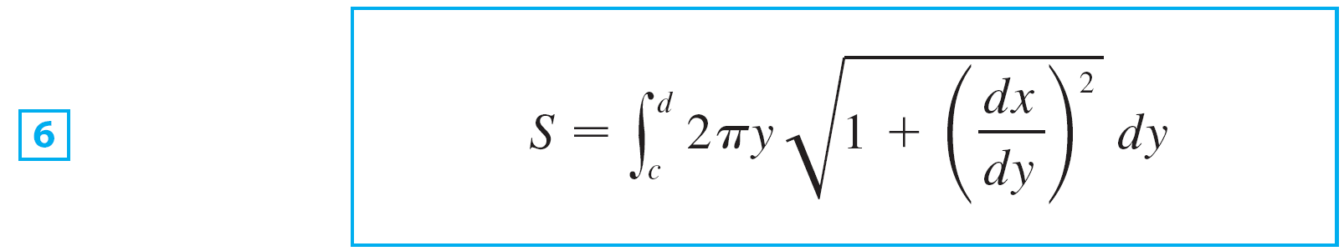

Area of a Surface of Revolution
If the curve is described as then the formula for surface area becomes
and both Formulas 5 and 6 can be summarized symbolically, using the notation for arc length as

Slide 14
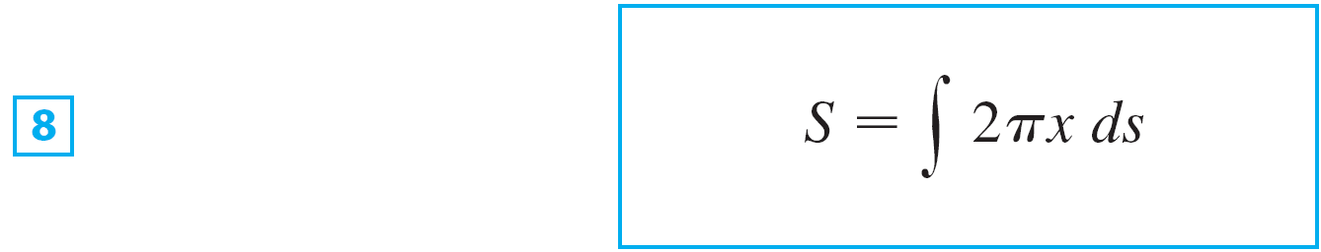
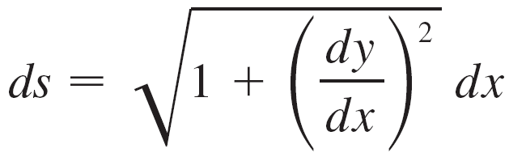
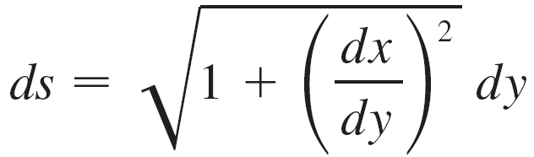
Area of a Surface of Revolution
For rotation about the y-axis, the surface area formula becomes
where, as before, we can use either
or

Slide 15
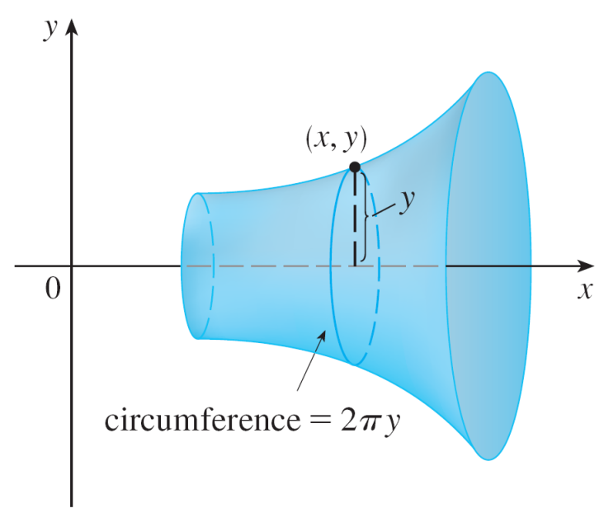
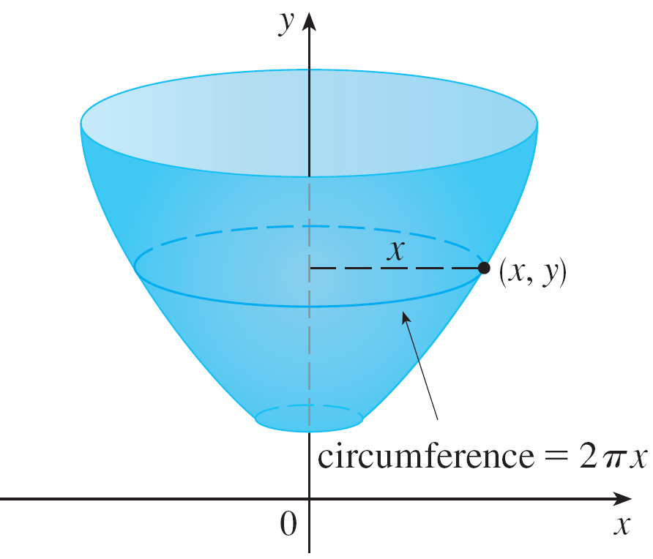


Area of a Surface of Revolution
These formulas can be remembered by thinking of 2π y or 2π x as the circumference of a circle traced out by the point (x, y) on the curve as it is rotated about the x-axis or y-axis, respectively (see Figure 5).
(a) Rotation about x-axis:
(b) Rotation about y-axis:
Figure 5

Slide 16


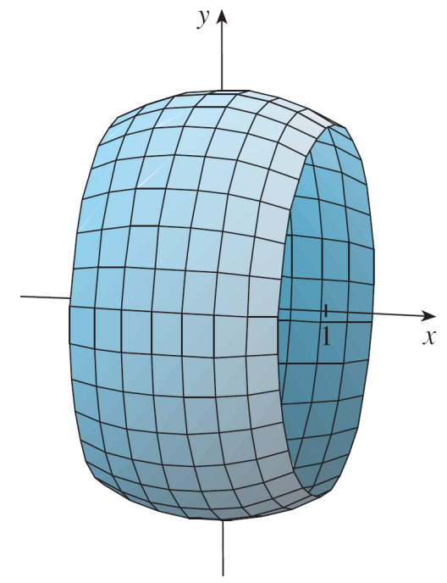
Example 1
The curve is an arc of the circle Find the area of the surface obtained by rotating this arc about the x-axis. (The surface is a portion of a sphere of radius 2. See Figure 6.)
Figure 6

Slide 17
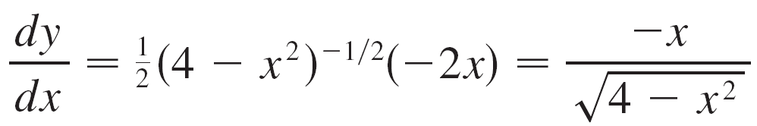
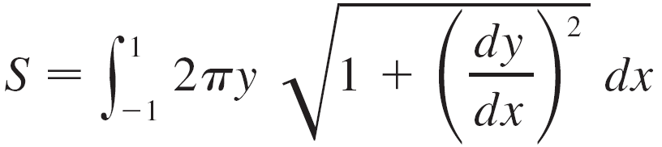
Example 1 – Solution
We have
and so, by Formula 5, the surface area is

Slide 18
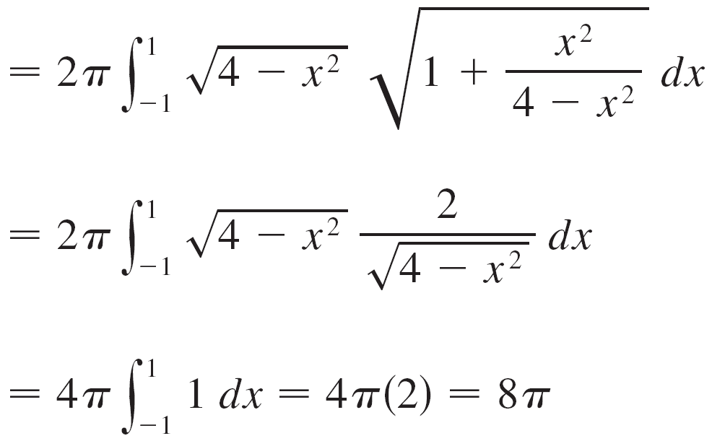
Example 1 – Solution
cont’d

Slide 19
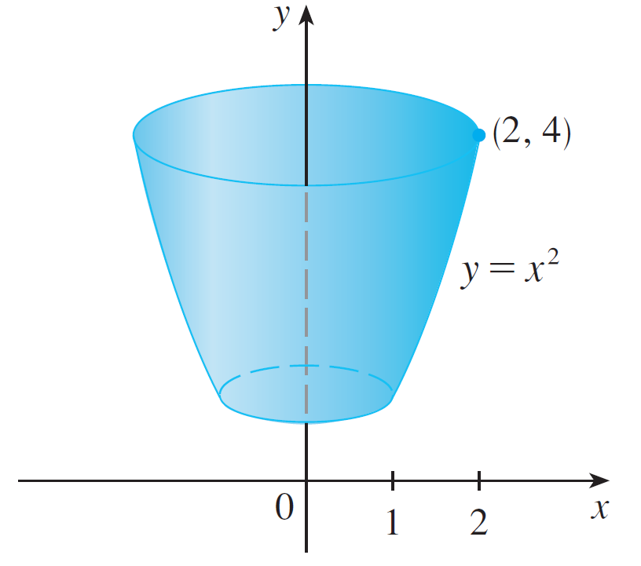
Example 2
The arc of the parabola y = x² from (1,1) to (2,4) is rotated about the y-axis. Find the area of the resulting surface.
Figure 7

Slide 20

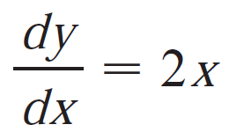
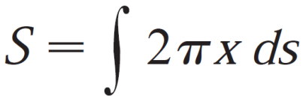
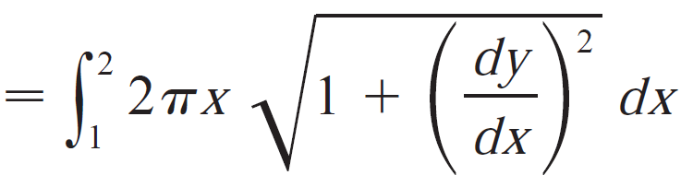
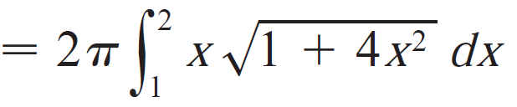
Example 2 – Solution
Solution 1
Using
we have, from Formula 8,

Slide 21
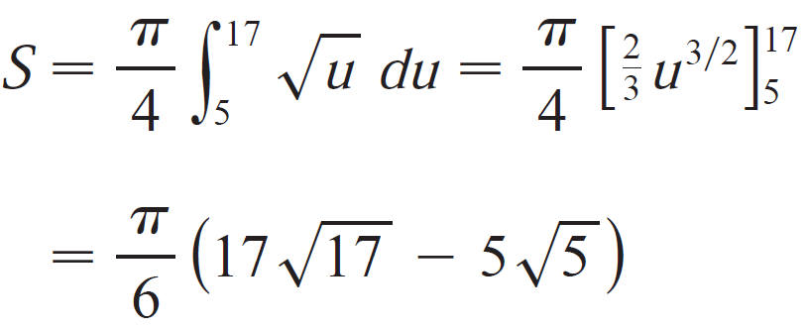
Example 2 – Solution
cont’d
Substitute u = 1 + 4x², we have du = 8x dx. Remembering to change the limits of integration, we have

Slide 22

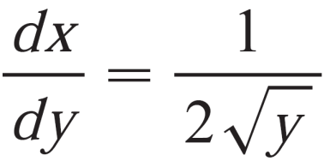
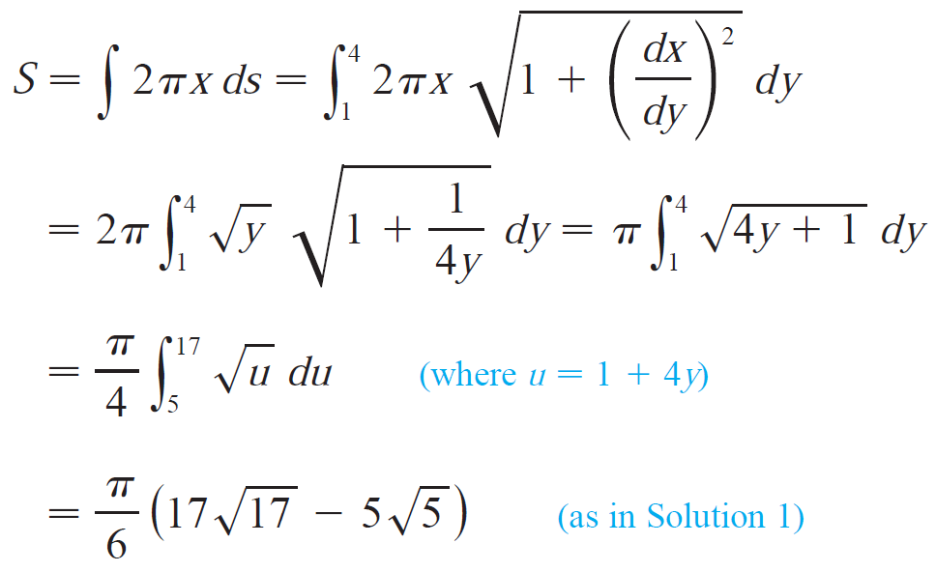
Example 2 – Solution
Solution 2
Using and
we have

